Slide 1


FAICE
Artificial Intelligence for face recognition

Slide 2

WHAT IS FAICE?
HOW ARE OUR RESULTS?
01
03
HOW IS OUR DATA?
WHAT DO WE DO NOW?
02
04
Aiming to accurately detect the gender and age of a person's photo.
Evaluating the results that we have obtained in relation to the predictions generated.
Exploring the looking of the photos we have used to train the AI model.
Defining the conclusions and next steps after having assessed the results obtained.

Slide 3
WHAT IS
FAICE?
01
Aiming to accurately detect the gender and age of a person's photo

Slide 4





FACE RECOGNITION
Gender
AI focused on recognizing and predicting the gender of a person using only an image of the user.
Age
In addition to classifying the age of the person, the AI will try to estimate the age of the user.
Ethnicity
Is ethnicity necessary to predict with certainty a person's sex and gender using a photo?

Slide 5
HOW IS OUR DATA?
02
A general exploration of what the photos we have are like

Slide 6




ANALYSIS OF THE PHOTOS
+60 years old
Female
48px
+20K pictures with a total number of 2304 pixels per image
The format of the pictures have a shape of 48 X 48 pixels.
48px
Wide variety of ages, genders and ethnicities in the photos
Black

Slide 7
ANALYSIS OF GENDER AND ETHNICITY
In relation to the gender of the people in the photos, we can observe that:
The 48% are female.
The 52% are male.
In relation to the ethnicity of the people in the photos, we can observe that:
The 46% are white.
The 19% are black.
The 17% are Indian.
The 15% are Asian.
The 7% are Hispanic.

Slide 8
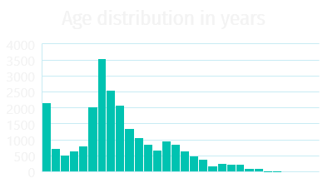
ANALYSIS OF THE AGE
In relation to the age of the people in the photos, we can observe that most of the persons are in an age between 25 and 45 years old.
In addition to this, we can highlight that:
The 19% are between 1 and 18 years old.
The 45% are between 19 and 35 years old.
The 26% are between 36 and 60 years old.
The 10% are more than 60 years old.
1 12 24 32 43 54 63 74 82 93 105 116

Slide 9
HOW ARE OUR RESULTS?
03
Evaluating the results that we have obtained in relation to the predictions generated.

Slide 10
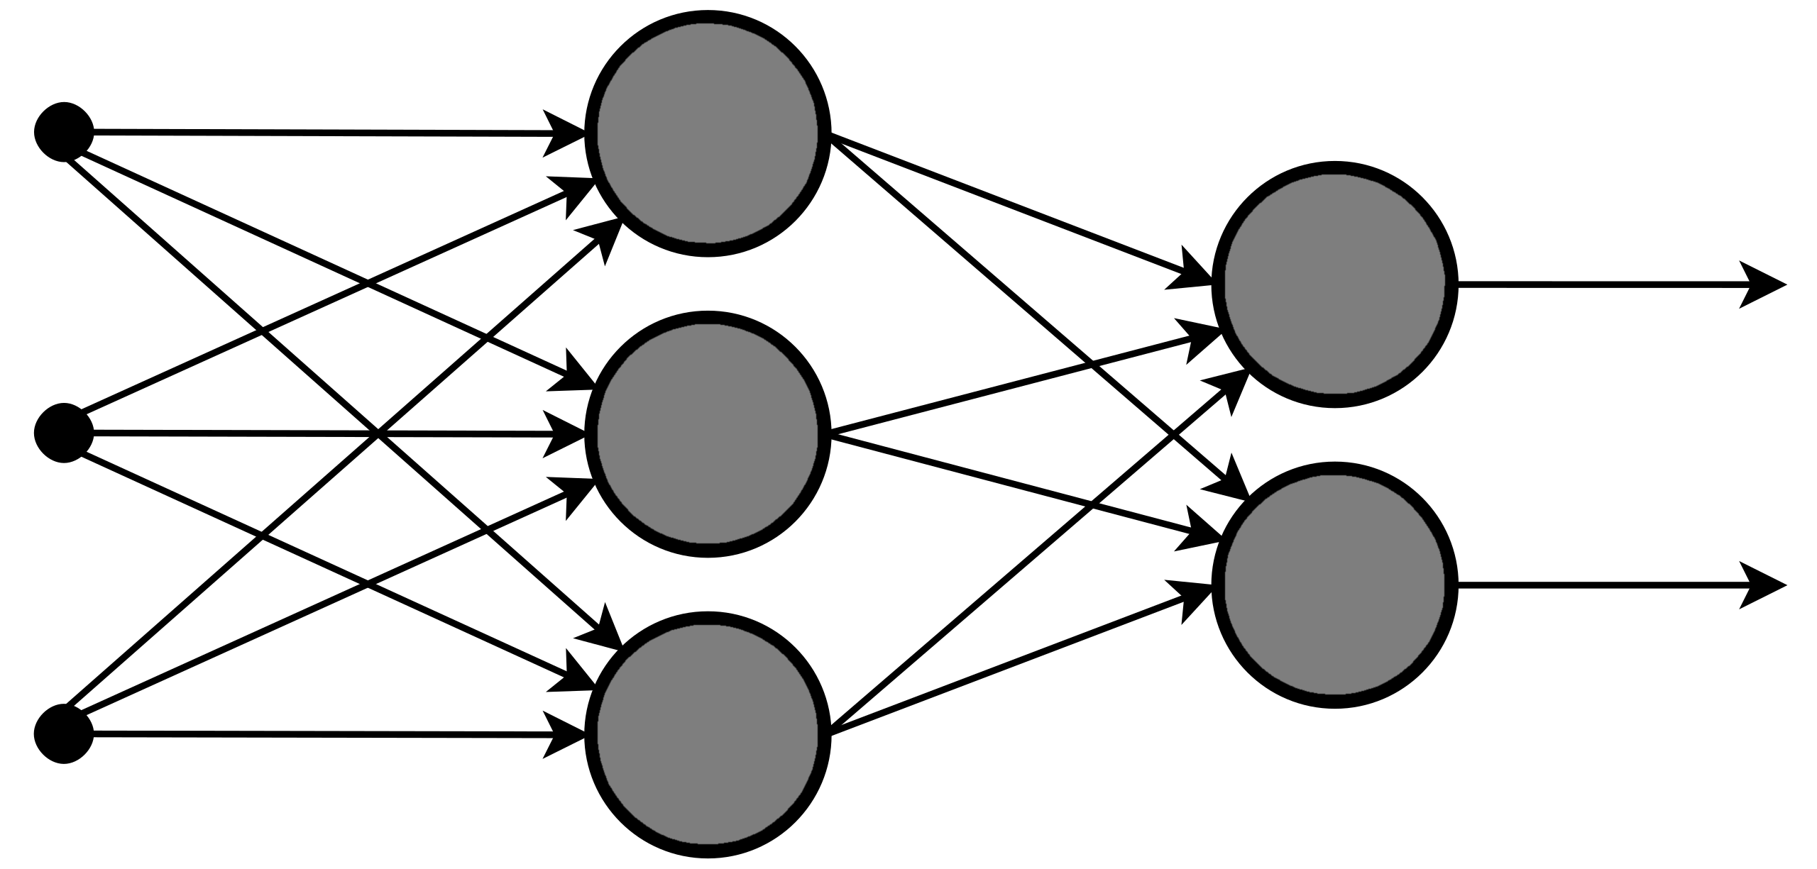
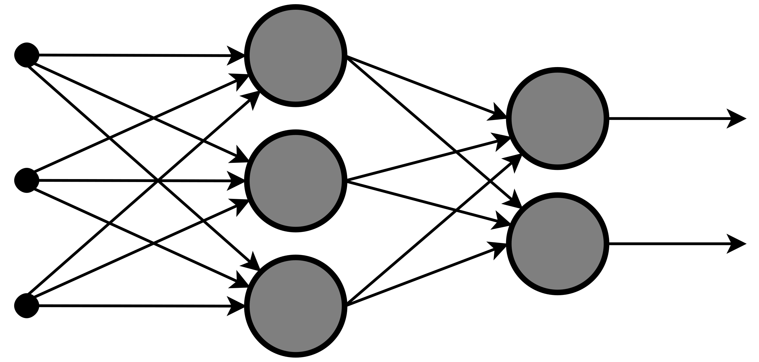
TRAINING THE NEURAL NETWORKS
Neural network to predict the gender of the person
V1: TRAINED ONLY IN WHITE FACES
V2: TRAINED IN ALL AVAILABLE FACES
IMAGE PIXELS
Neural network to predict the age of the person
V1: TRAINED ONLY IN WHITE FACES
V2: TRAINED IN ALL AVAILABLE FACES

Slide 11
PREDICTING THE GENDER – V1
V1 - TRAINED ONLY IN WHITE FACES
WHITE PEOPLE IMAGES
NON WHITE PEOPLE IMAGES
ACCURACY
88%
83%
PRECISION
88%
80%
RECALL
90%
90%
F1
89%
85%

Slide 12
PREDICTING THE AGE – V1
V1 - TRAINED ONLY IN WHITE FACES
R2 SCORE
MSE
MAE
70%
150.13
4.26
WHITE PEOPLE
IMAGES
60%
120.69
5.89
NON WHITE
PEOPLE IMAGES

Slide 13


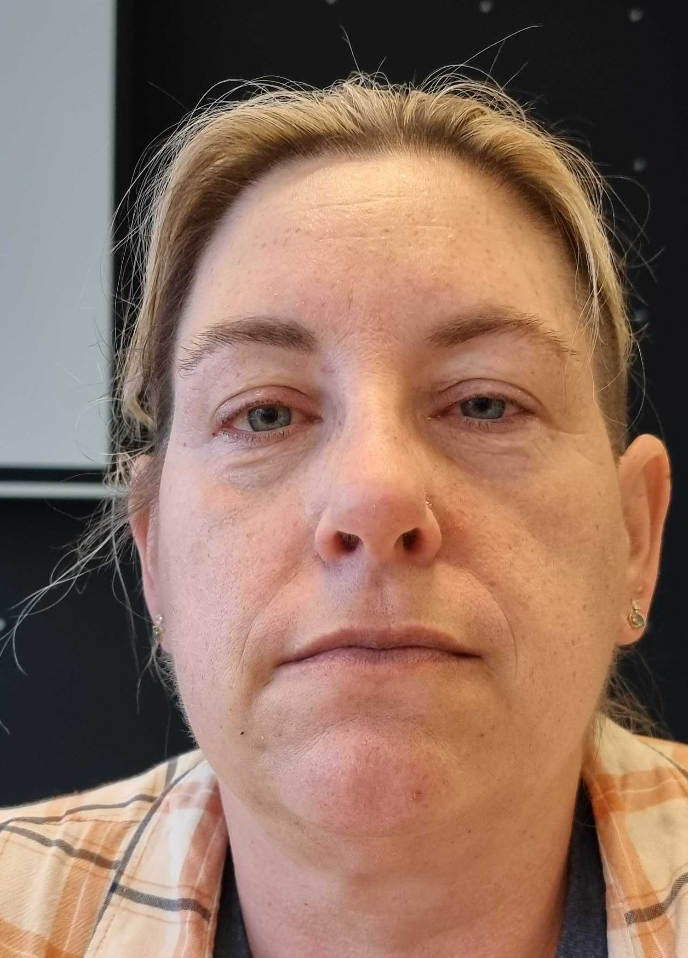
TEACHER AND TAS PREDICTIONS
TRAINED ONLY IN WHITE FACES
TRAINED IN ALL FACES
Man: 79% - 71%
Age: 5 - 19
Man: 99% - 97%
Age: 33 - 54
Woman: 69% - 63%
Age: 6 - 31
Frederico
Jan
Erin

Slide 14



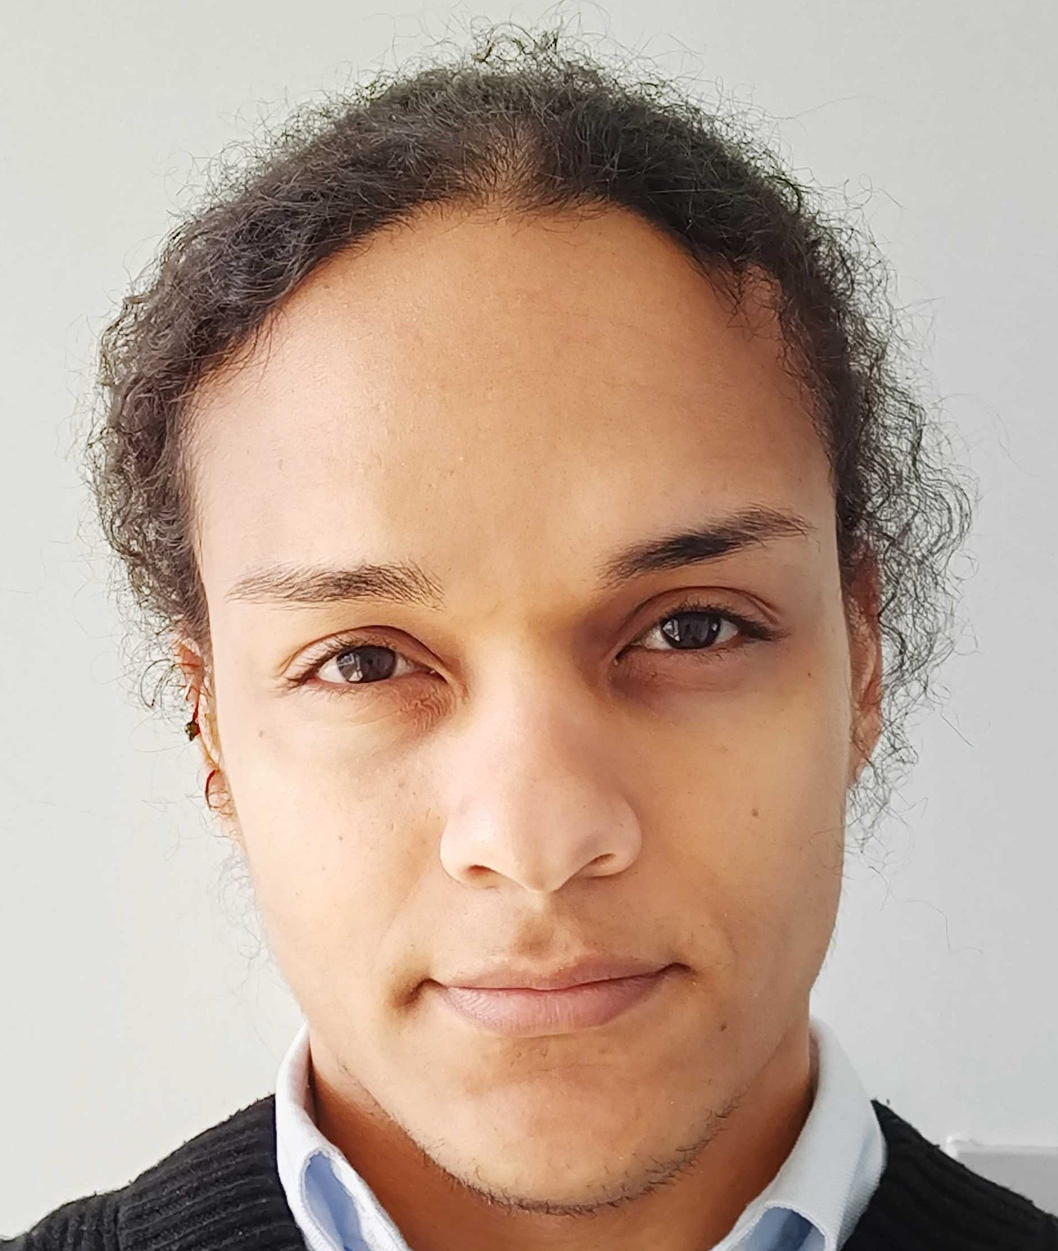
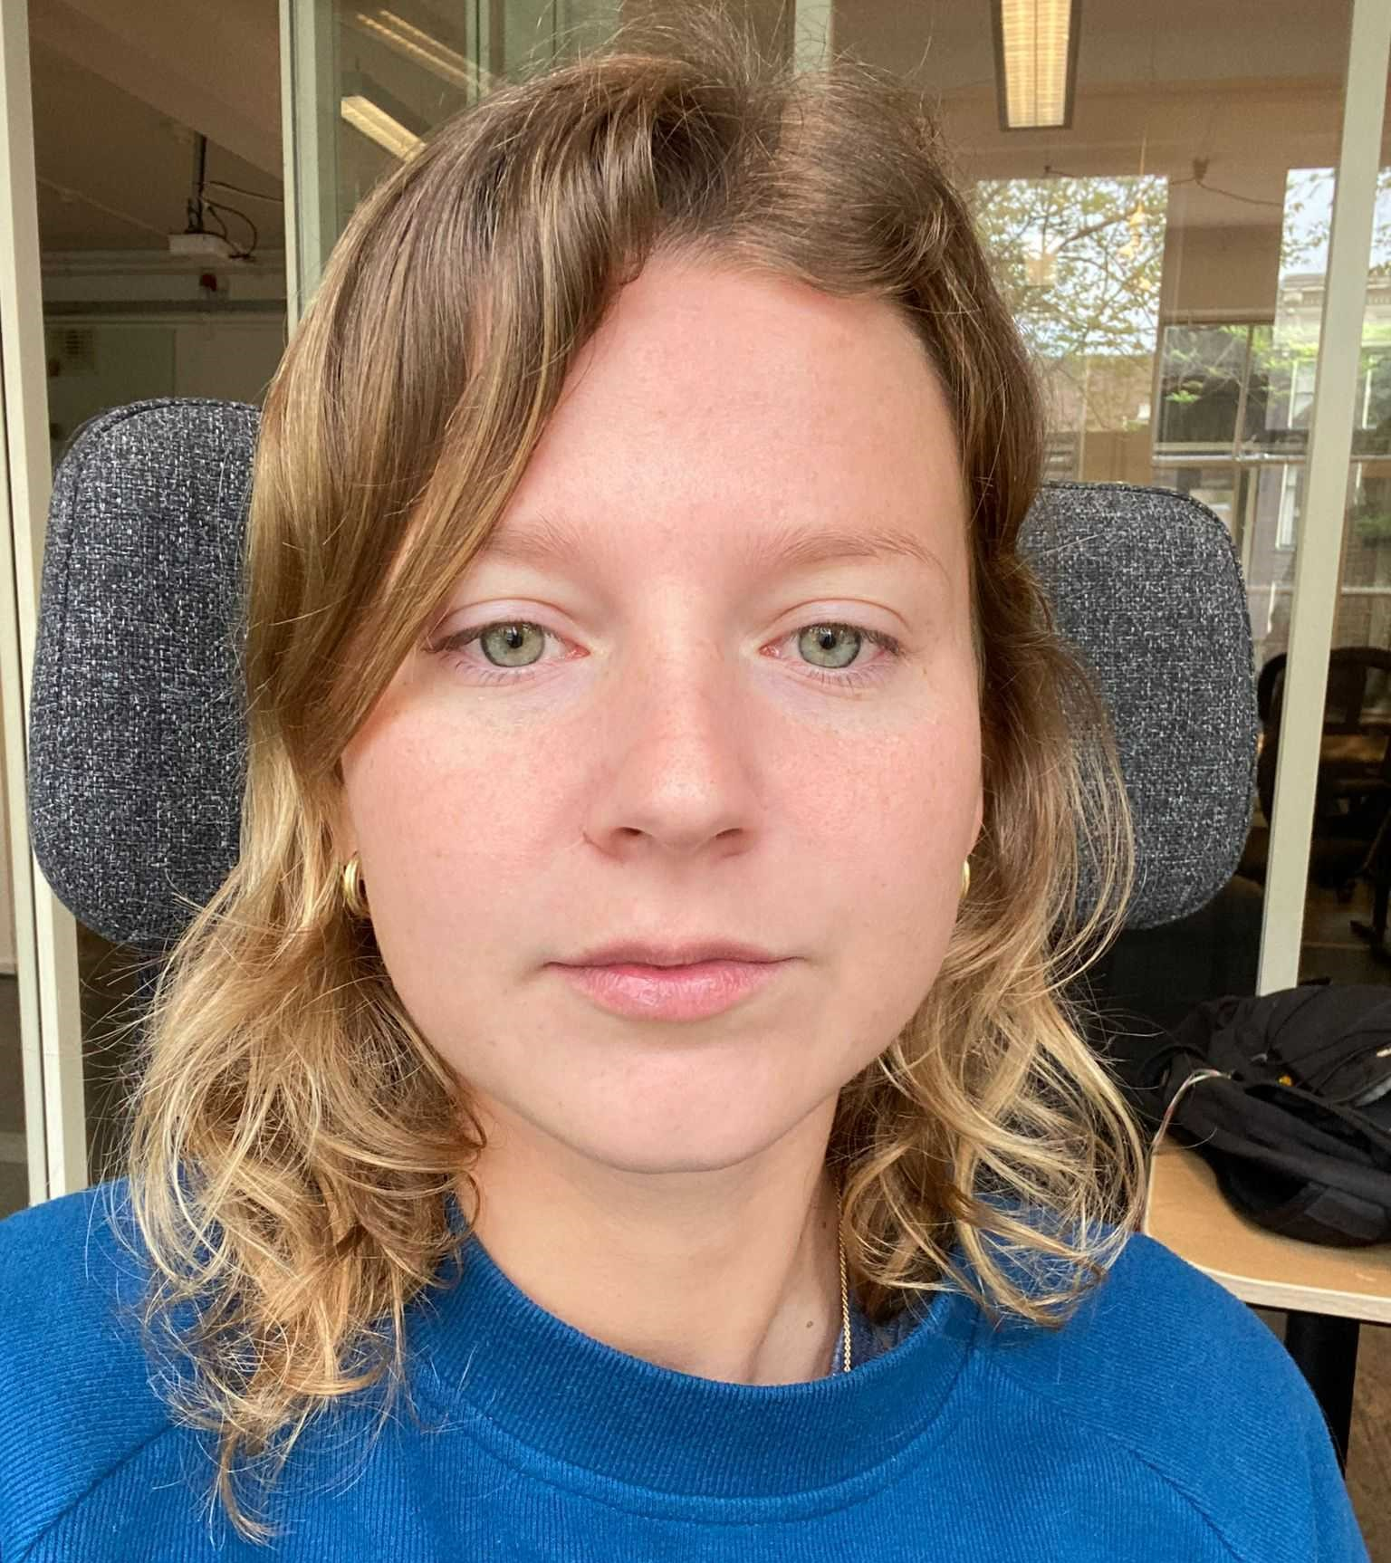
CLASSMATES PREDICTIONS
TRAINED ONLY IN WHITE FACES
TRAINED IN ALL FACES
Man: 99% - 99%
Age: 39 - 38
Man: 90% - 92%
Age: 19 - 33
Woman: 71% - 89%
Age: 14 - 35
Men: 1% - 61%
Age: 14 - 26
Woman: 100% - 100%
Age: 12 - 24
Gonzalo
Hamza
Inés
Ishmael
Jorien

Slide 15
87.5% - 100%
PREDICTING THE GENDER OF THE IRONHACKERS 😎
TRAINED ONLY IN WHITE FACES
TRAINED IN ALL FACES

Slide 16
-2.5% - 30%
PREDICTING THE AGE OF THE IRONHACKERS 🤔
TRAINED ONLY IN WHITE FACES
TRAINED IN ALL FACES

Slide 17
WHAT DO WE DO NOW?
04
Defining the conclusions and next steps after having assessed the results obtained.

Slide 18
CONCLUSIONS
01 | 02 | 03 | 04
Gender of a person can be predicted with only an image | Ethnicity of a person is not essential to predict the gender | Age of a person is harder to predict than the gender | Ethnicity of a person can be essential to predict the age

Slide 19
NEXT STEPS
01 | 02 | 03 | 04
Try to predict the age of a person inside of an age range | Try to predict the age of a person dividing the date by ethnicity | Perform an augmentation of all the images to count with more data | Try different neural networks structures to evaluate the performance

Slide 20

THANKS!
Do you have any questions?
sergio.pm.97@protonmail.com
+34 608 322 336
Sergio Peña Muñoz

